Slide 1
Bank Customer Churn Predication
Ritesh Kumar
March 13th, 2022

Slide 2
Overview
Customer churn (also known as customer attrition) occurs when a customer stops using a company's products or services. Customer churn affects profitability, especially in industries where revenues are heavily dependent on subscriptions (e.g . banks, telephone and internet service providers, pay-TV companies, insurance firms, etc.). It is estimated that acquiring a new customer can cost up to five times more than retaining an existing one. Therefore, customer churn analysis is essential as it can help a business:
Identify problems in its services (e.g .poor quality product/service, poor customer support, wrong target audience, etc.), and
make correct strategic decisions that would lead to higher customer satisfaction and consequently higher customer retention.

Slide 3
Objective
The goal of this project is to understand and predict customer churn for a bank. Specifically, we will initially perform Exploratory Data Analysis (EDA) to identify and visualise the factors contributing to customer churn. This analysis will later help us build Machine Learning models to predict whether a customer will churn or not.
This problem is a typical classification task. The task does not specify which performance metric to use for optimising our machine learning models. I decided to use ROC curve, it is able to detect more numbers of True positives and True negatives than False negatives and False positives

Slide 4
Exploratory Data Analysis (EDA)
The bank kept 80% of its clientele.
Notice that our dataset is skewed/imbalanced since the number of instances in the 'Retained' class outnumbers the number of instances in the 'Churned' class by a lot. Therefore, accuracy is probably not the best metric for model performance.
Continuous Feature
The older customers are churning at more than the younger ones alluding to a difference in service preference in the age categories. The bank may need to review their target market or review the strategy for retention between the different age groups
There is no significant difference in the credit score distribution between retained and churned customers.
The salary has a significant effect on the likelihood to churn.
Worryingly, the bank is losing customers with significant bank balances which is likely to hit their available capital for lending.

Slide 5
Categorical Feature
Majority of the data is from persons from France. However, Customers in Germany are more likely to churn than customers in the other two countries (the churn rate is almost double compared to Spain and France) Many reasons could explain this finding, such as higher competition or different preferences for German customers.
There are more male customers than females, However, proportion of female customers churning is greater than that of male customers.
Only a small percentage leaves within the first year. The count of customers in tenure years between 1 and 9 is almost the same. The number of years (tenure) does not seem to affect the churn rate.
Most of the customers have purchased 1 or 2 products, while a small portion has purchased 3 and 4. And having 3 or 4 products significantly increases the likelihood of churn. It could potentially mean that the bank cannot properly support customers with more products which in turn increases customer dissatisfaction.
A significant majority of customers has a credit card and, but it seems having a credit card does not affect the churn rate.
Almost 50% of customers are not active. And it's not a surprise that inactive customers are more likely to churn .Therefore, the bank will benefit from changing its policy so that more customers become active.

Slide 6
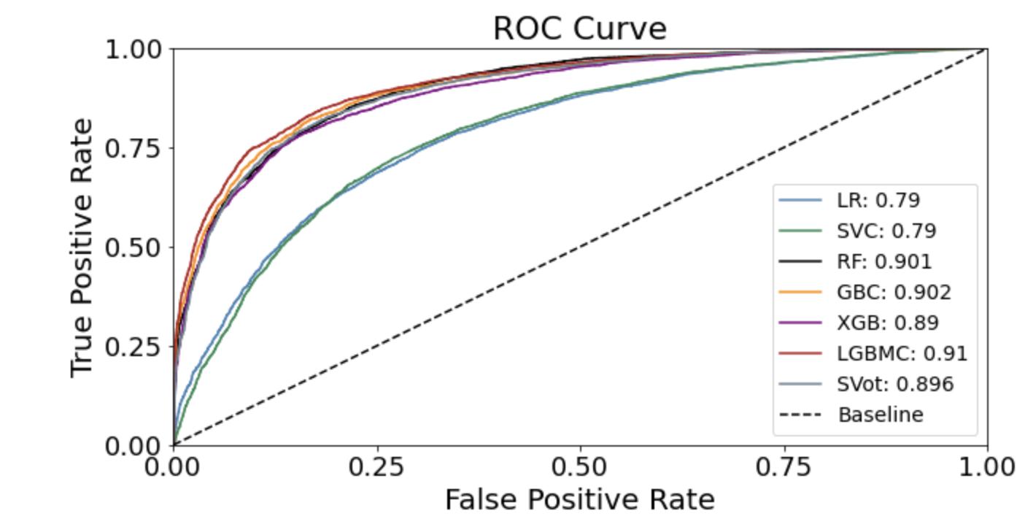
Model/ Algorithm Performance Train Data

Slide 7
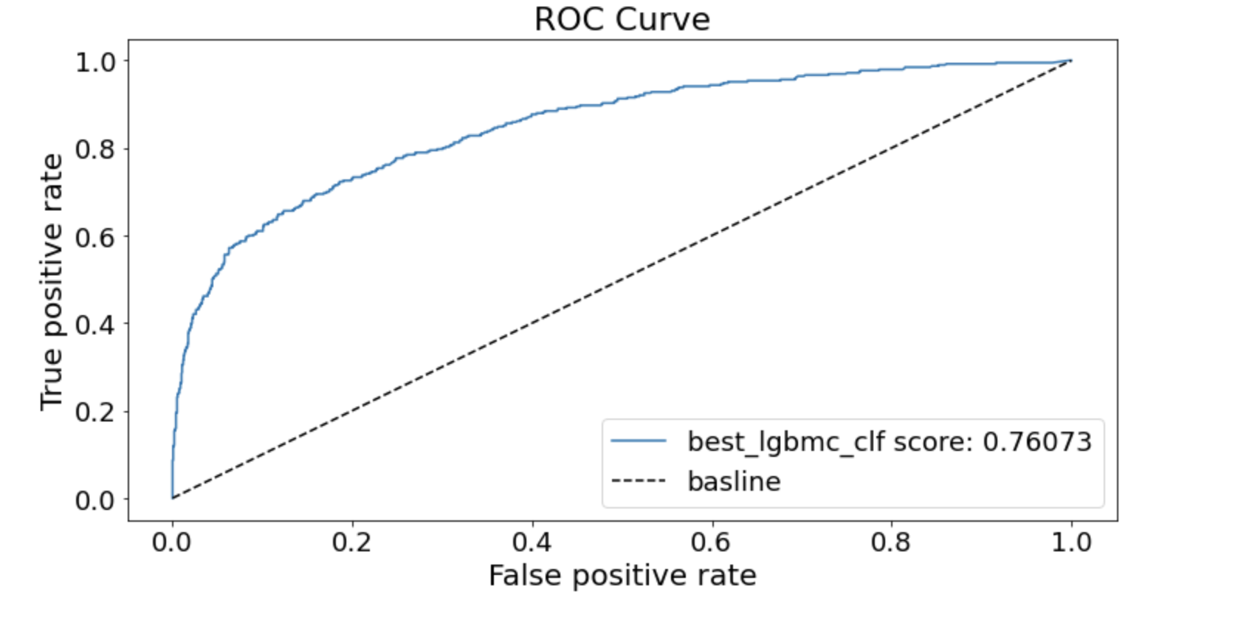
Model/ Algorithm Performance Test Data

Slide 8
Conclusions
In ROC Curve , all classifiers, apart from Logistic Regression, perform similarly. It seems that LGBM performs marginally better, as evidenced by the slightly higher AUC (0.91) on Train Data
In Test Data also LGBM perform better with AUC (.78).
Perhaps, adding more features or/and records could help us improve predictive performance. Therefore, the bank could benefit from investing in gathering more data.

